Slide 1
L4/5 GROUP 2
Jordan Marks
Alice Baker
Thomas Gibbs
Daniel Pokladek

Slide 2
The brief
Physics based game
Easy to learn game yet hard to master

Slide 3
Logline and target audience
Logline – Beat your Foes in this gravity based planetary arena.
Target audience - 18-35 Male and Female
Platform – Mobile

Slide 4
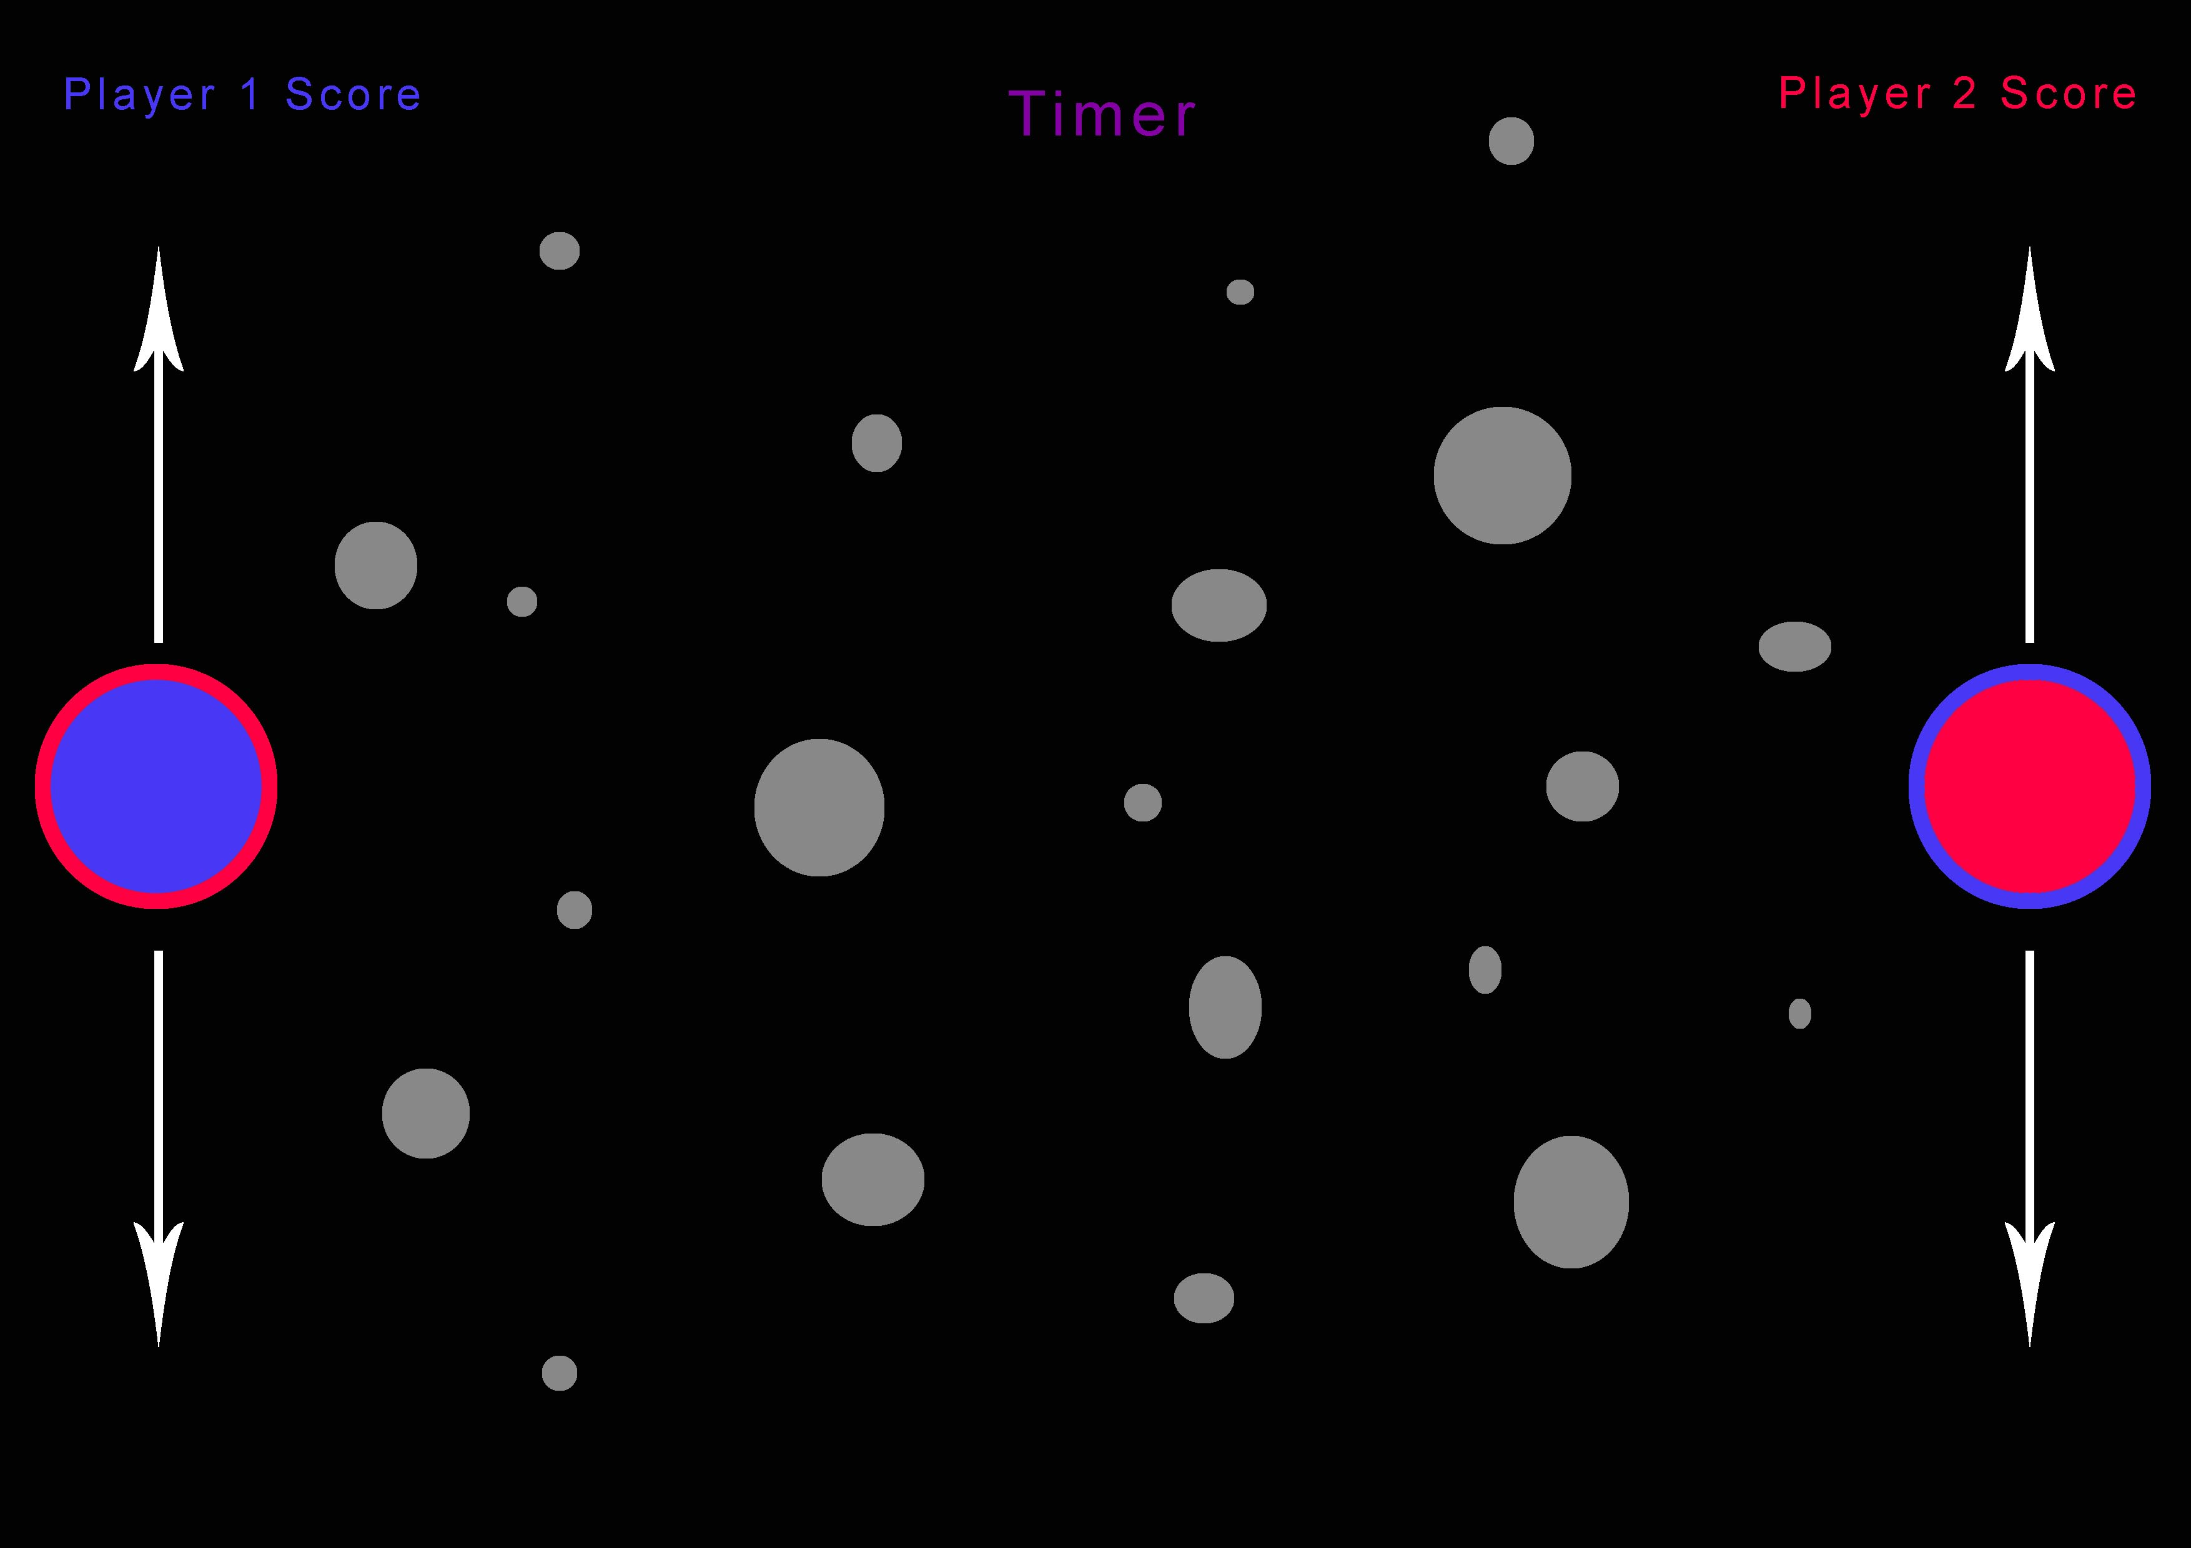
game concept
Easy to play.
Simple yet has complex gameplay.
Physics-based gameplay.

Slide 5
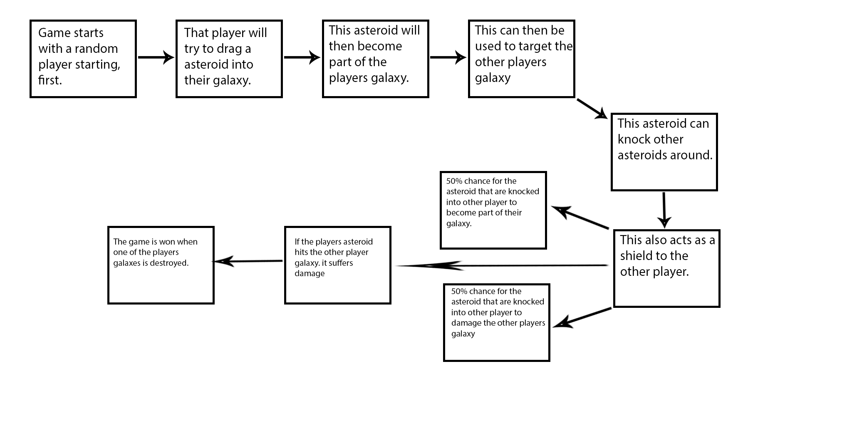
game concept

Slide 6
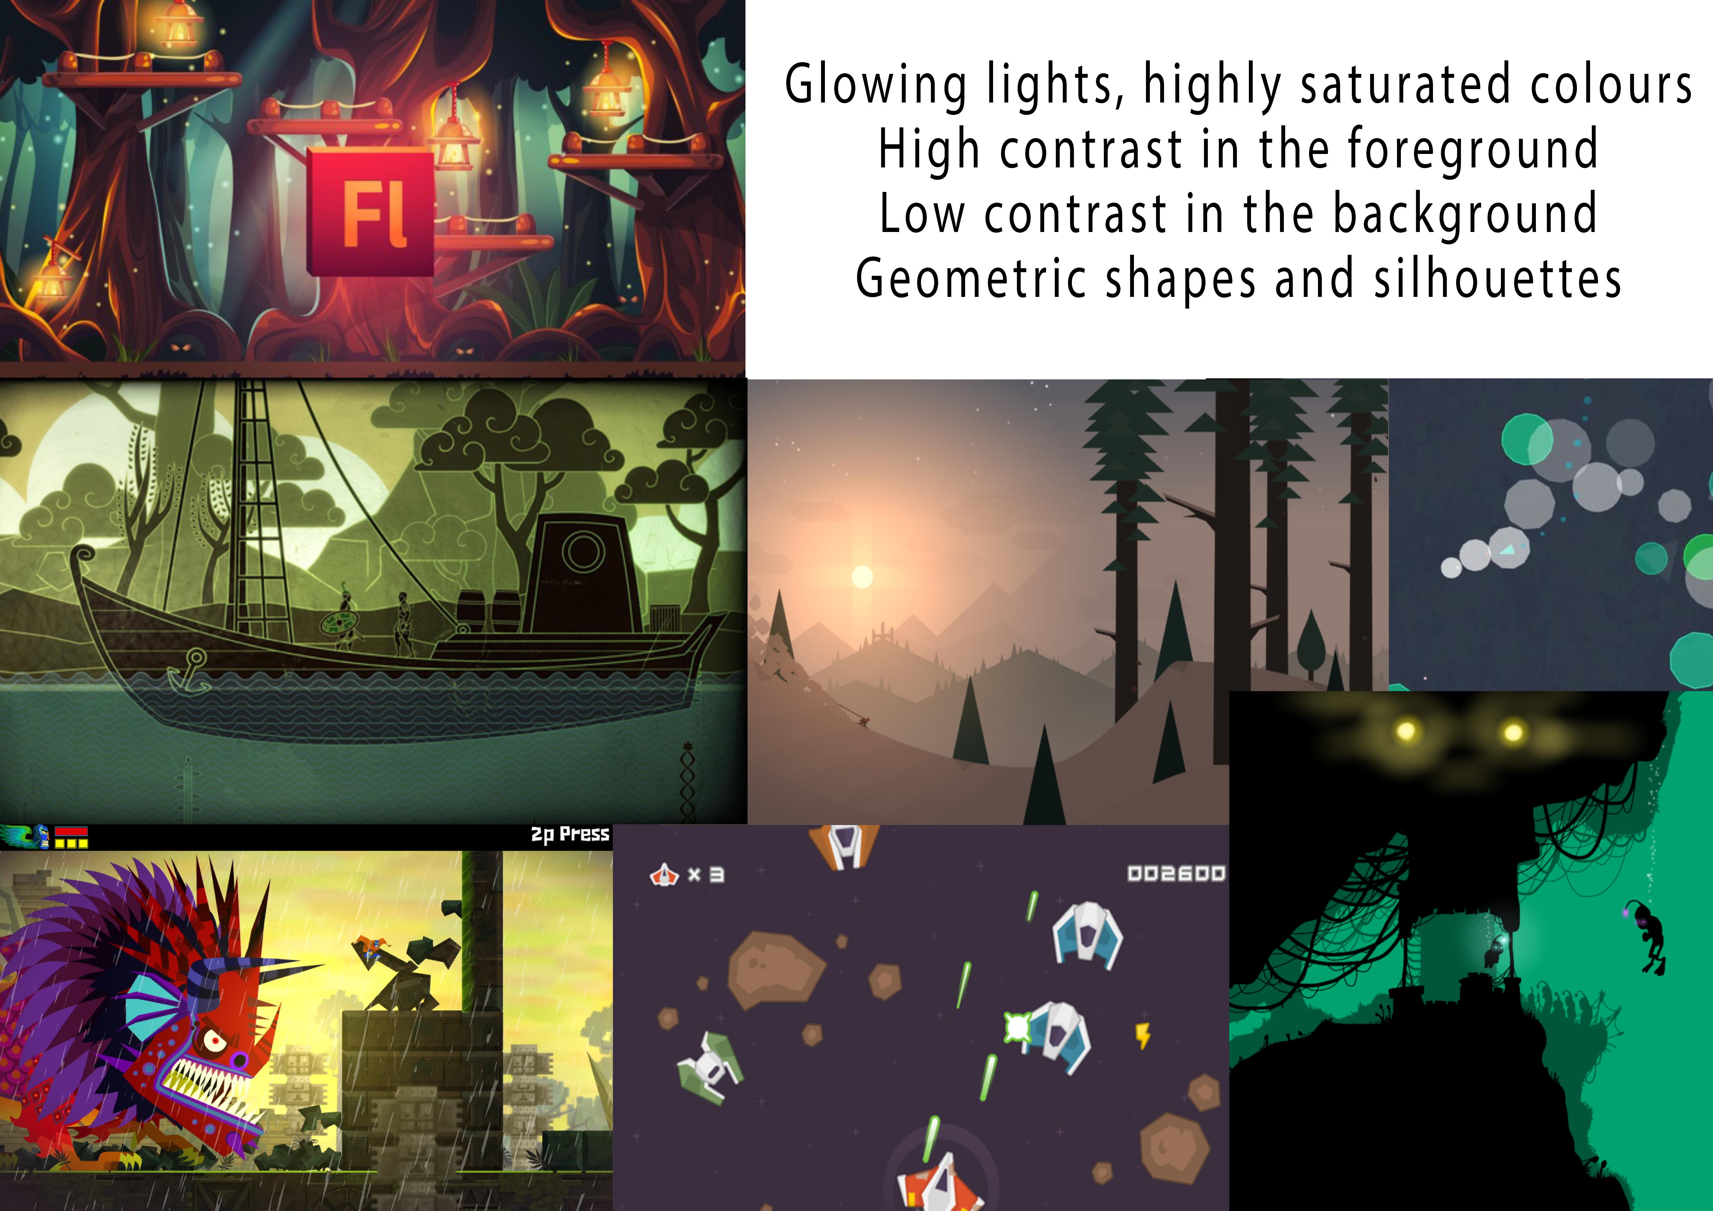



Art style and Moodboard

Slide 7
Prototypes

Slide 8
Questions?

